Slide 1
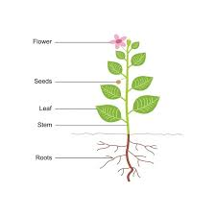
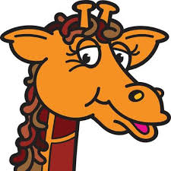


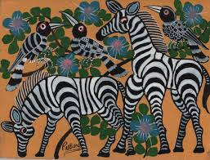
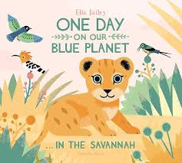
Science
Plants
- identify and describe the basic structure of a variety of common flowering plants and observing seeds
Materials
- Compare a variety of everyday materials based on their physical properties
Animals
- identify and name a variety of common animals that are carnivores, herbivores and omnivores
Seasonal changes
- Observe changes across the 4 seasons.
- Observe and describe weather associated with the seasons and how day length varies.
Geography
Physical and human features of countries within the UK
UK climate – weather across the year
Exploring world climate zones
Country study: locating, mapping, human and physical features and exploring life in rural Kenya
Compare physical and human features of Gloucestershire and Kenya
Wellbeing- Being my best and growing and changing
I can eat a rainbow
Eat well
Harold’s wash up and brush up
Catch it! Bin it! Kill it!
Harold learns to ride his bike
Pass on the praise
Healthy me
Taking care of my body
Year One
Terms 5 and 6 2025
Computing
Creating media - digital writing
Programming B - programming animations
Fractions: looking at ½, 1/4and 1/3 amounts.
Positions: looking at turning a quarter and half a turn.
Adding and subtracting.
Recognizing money values.
Counting in equal steps
P.E
Heron Active 15
Outdoor and Indoor ball skills
Sports day practice
Music
Pulse
Rhythm
Voice as an instrument
Composition
Playing as an ensemble
R.E.
Who do Christians say made the world – Creation
How should we care for others and the world and why does it matter?
.
History
In History we will be looking at the First World War and some of the key events that happened.
Maths
English
Our focus story: Lila and the secret of rain and One day on our blue planet.
Capital letters
Full stops
Finger spaces
Story writing and planning
Adjectives
SPaG
Art and Design
Our focus artist: Edward Tinga
We will be printing and creating safari patterns using Edward as an inspiration.
D.T.
We will be making our own safari vehicles using structures and joining skills.

